Slide 1

BENV0091 Lecture 5: Dates and Times
Patrick de Mars

Slide 2
Lecture Overview
Intro to dates, times and the lubridate package
Time series forecasting (Renewables Ninja)
Kaggle competition launch!

Slide 3
Challenges of Dates and Times
Handling dates and times (AKA date-times) in R (and other languages) can be challenging
There is no universally used format for dates and times:
9am 25th Dec 2021
2021-12-25 09:00
9:00:00 2021/12/25
Furthermore, local time zones (including daylight savings) mean that the time isn’t the same everywhere in the world
Coordinated Universal Time (UTC) is the standard time zone that is most widely used as a reference point, but often the local time is more informative
Plus leap years (and even leap seconds) can pose problems! Not every day has 24 hours...

Slide 4
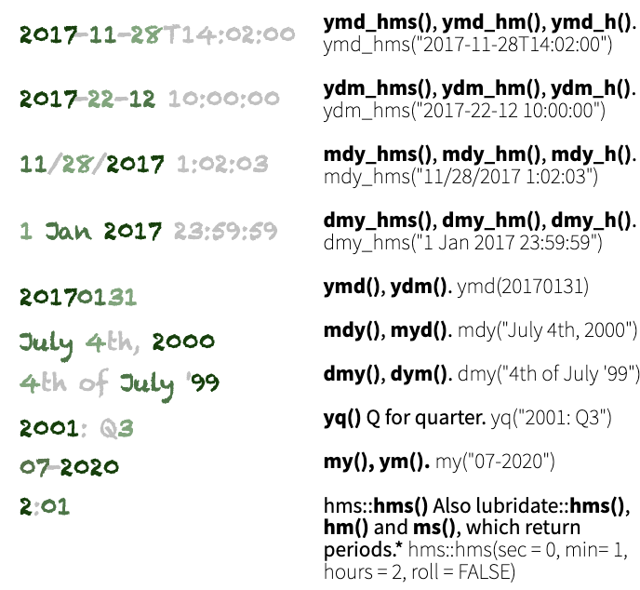
Parsing Dates and Times
From the lubridate cheat sheet
Dates and times should be treated as their own data types: not as strings!
There are 3 types of date/time object:
date
time
date-time (AKA POSIXct)
When you read in data with a timestamp or date column, it will often not be automatically converted to date/time data
The lubridate package has intelligent functions like `ymd()` or `dmy_hms()` for converting to date/time objects
Identify the order of years, months, days, hours, minutes and seconds, then apply the relevant function on the right
Task: convert the following dates/times to date or date-time variables:
March 3rd 2003
16:00:00 14.11.2030
Tuesday 2nd August 1966 7:30pm

Slide 5
Date-Time Arithmetic
now() gives the current time as a date-time object
Date/time data can be added or subtracted
Using `seconds()`, `months()`, `years()` etc. gives a period which can be added
Tasks:
Calculate out the time in 123456789 seconds from now
Calculate your age by taking the difference between today and your DOB
There are some subtleties when adding or subtracting date/times; you must consider whether you want to consider irregularities in the time line.
Suppose you want to know the time 3 hours after Saturday 30th October 2021 at 11pm (the night the clocks go back): 2am or 1am?

Slide 6
Converting Time Zones
When you create a date-time object, the time zone will be UTC unless you specify otherwise with the `tz` argument
You can convert a date-time object to a different time zone by specifying `tz =` when using any of the date-time parsing functions:
`as_date(datetime, tz = timezone)`
`ymd_hms(datetime, tz = timezone)`
The time zone codes and UTC offsets are taken from the tz database and generally have the form “region/place”
The tz database accounts for daylight savings time where in places where it is used
Task: create a date-time variable for 1st April 1980 5am with the UTC time zone, then convert to:
Europe/London (06:00 BST)
Asia/Tokyo (14:00 JST)
America/Los_Angeles (21:00 PST)
TZ Name | UTC Offset
Africa/Cairo | +02:00
Pacific/Honolulu | -10:00
Europe/Brussels | +01:00
America/Chicago | -06:00

Slide 7
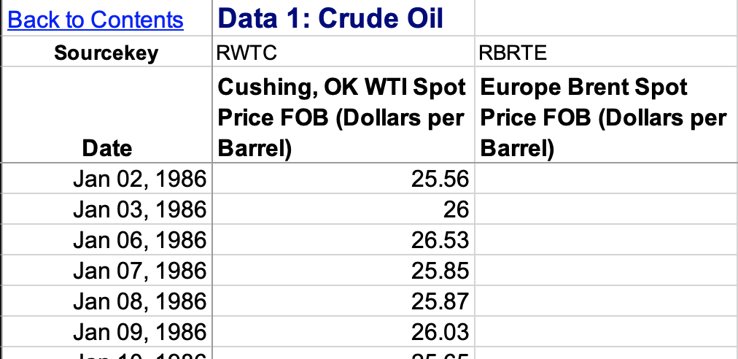
Filling NAs
Task: read the crude oil price data using `read_excel()` from the readxl package:
Skip the first two rows
Choose the sheet named “Data 1”
Rename the columns (see right)
This daily crude oil price (WTI) data has a few missing values
Task: count the number of NAs in the WTI column
We can get rid of these values with `drop_na()` but we will lose valuable data!
Alternatively, we can attempt to fill in (impute) the missing data points

Slide 8
Imputation
Methods which impute missing values of column X using information from column X alone are univariate. Methods include:
Taking the mean, max or other statistic
Interpolation (linear, splines…)
Carry forward/backward
Multivariate imputation uses other variables to predict the missing values
Univariate methods are particularly appropriate for time series, because often adjacent values are similar to each other
Task: use na.approx() from the zoo package to fill the NA values in the WTI oil price time series
zoo functions for univariate imputation:
na.approx()
na.locf()
na.aggregate()
na.spline()
R packages for multivariate imputation:
missForest
mice
Amelia
mi

Slide 9
Resampling Time Series
Often, we want to change the resolution of a time series to match another data set
Electricity metered at 30 minute resolution, gas metered at 1 hour resolution
Daily oil prices, half-hourly electricity prices
The methods for resampling depend on whether we want to increase or decrease the resolution:
Reduce resolution → aggregate
Increase resolution → impute or aggregate
Task: upsample the oil price data to 30 minute resolution
Task: impute the missing WTI data with a method of your choice

Slide 10
Moving Averages
A useful and interpretable way to indicate a trend over time is a moving average
Moving (or rolling) average typically calculates the mean over a rolling window
The `rollmean()` function from zoo is a good option for calculating rolling averages (or you can write your own function!)
Code available from the Github repo

Slide 11
Introduction to Forecasting

Slide 12
Data: Renewables Ninja
Renewables Ninja runs simulations of hypothetical solar PV or wind turbines for a specified location, based on weather data
We will use hourly simulated solar PV production for a solar panel on the Institute of Education building (51.5231, -0.1281)
Task: read the data into an object called `ninja`
Note there are two time columns:
time (UTC)
local_time (considers local time zones, including daylight savings)

Slide 13
Retrieving Date-Time Components
Once you have a correctly formatted a date-time, you can easily retrieve components of the date-time
Task: use mutate() to add hour, week and date columns to your data frame
Task: produce the plot on the right hand side!
geom_col() shows the mean production by hour
geom_errorbar() shows the range
Use week() to retrieve week number from a date-time, year() to retrieve year etc.

Slide 14
Autocorrelation
Use acf(vector, lag.max = N) to plot the autocorrelation function for vector with a maximum lag of N
Autocorrelation measures the correlation between a series and a delayed version of itself
It is useful for determining patterns and periodicity of time series, which can be useful for feature generation
Task: produce the plot on the right with the `acf()` function

Slide 15
Solar PV Forecasting
Our task will be to forecast the (simulated) solar PV output 24 hours ahead
In this lecture we will adopt a machine learning approach, using supervised learning methods that are equally applicable in non-time series contexts
However, there is a rich literature of traditional time series forecasting methods, including:
Exponential smoothing
Autoregressive moving average (ARMA)

Slide 16
Data Pre-Processing and Train/Test Splitting
It is important to get the data pre-processing and train/test split steps for forecasting tasks right as there are serious risks of data leakage:
Including measurements from the target time as features in the model
Including adjacent observations in test and train data
To avoid (1), observations from the target period shouldn’t be used to train the model!
To avoid (2), the test set is often set to be the last segment
Task: split the data such that all pre-October data is for training; the remained is for testing

Slide 17
Cyclical Date/Time Features
Dates and times are cyclical: hour 24 is adjacent to hour 1, December is adjacent to January
If we encode dates/times as numeric variables, then we cannot immediately capture the cyclical nature
A categorical encoding could also work, but this loses the continuous nature of dates and times and can make the model harder to learn
One option to create a numeric (continuous) encoding that captures the cyclical nature of dates/times is to use the sine and cosine functions
Task: use mutate() to create new variables for hour and weeks:
sin_week, cos_week
sin_hour, cos_hour
For variable with period T:
cos_var = 2π cos(var / T)
sin_var = 2π sin(var / T)

Slide 18
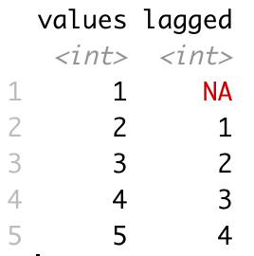
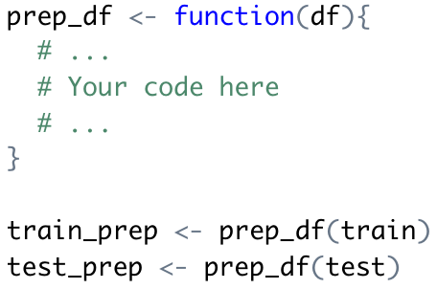
Lagged Variables
Use lag(vector, N) to create a new vector that is lagged by N steps, with the initial values padded with NA
Task: create a function for pre-processing your data
Add 24 hour lagged variables for:
Electricity
Direct irradiance
Diffuse irradiance
Temperature
Add the sine and cosine transforms of week and hour variables
Task: pre-process your training and testing data separately with the cleaning function
Task: drop the NA values from your training data
Lagged values with N=1

Slide 19
Fitting Models
This week we will introduce a new model: the random forest
Random forests fit many different decision trees using different features (sampled randomly) and take the mean estimates from each
Task: fit the following models to the training data
Linear Regression
Decision Tree (minsplit = 10)
Random Forest (ntree = 200)
Use randomForest(formula, data, arguments…) to fit a random forest model

Slide 20
Evaluating the Models
Task: calculate the predictions based on the training data, storing them in a data frame with the following columns:
Timestamp
Actual value
Linear model prediction
Decision tree prediction
Random forest prediction
The simplest forecast assumes that the forecast is the same as the last observation: called a naïve forecast or persistence forecast
Task: add a naïve (persistence) forecast
Task: calculate the RMSE of each of the models

Slide 21
Plotting Predicted vs. Actual
Now we will investigate the residuals for each model
Task: plot the predicted vs. actual values for each model
Task: colour each point by quarter
Task: plot the residuals of the random forest model with respect to time

Slide 22
Kaggle Competition

Slide 23
APIs

Slide 24
APIs
Client
An Application Programming Interface (API) is a set of rules or conventions determining how a user (or client) can request data from a producer (server)
Server: runs the API
Client: exchanges data with the server via an API
API: interprets requests to facilitate the exchange of data between client and server
API
Server

Slide 25
Examples of APIs
Hyrum’s Law
Each time you refresh your Twitter feed, a request is made to Twitter’s API, which returns the latest data
Weather forecasts
Carbon intensity
Flight times
Twitter
With a sufficient number of users of an API, it does not matter what you promise in the contract: all observable behaviors of your system will be depended on by somebody.

Slide 26
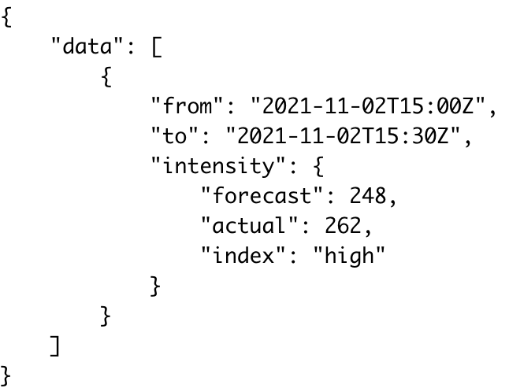
National Grid’s Carbon Intensity API
Task: use GET and the URL on the right to make a request for the current carbon intensity
jsonlite::prettify(content(r, ‘text’))

Slide 27
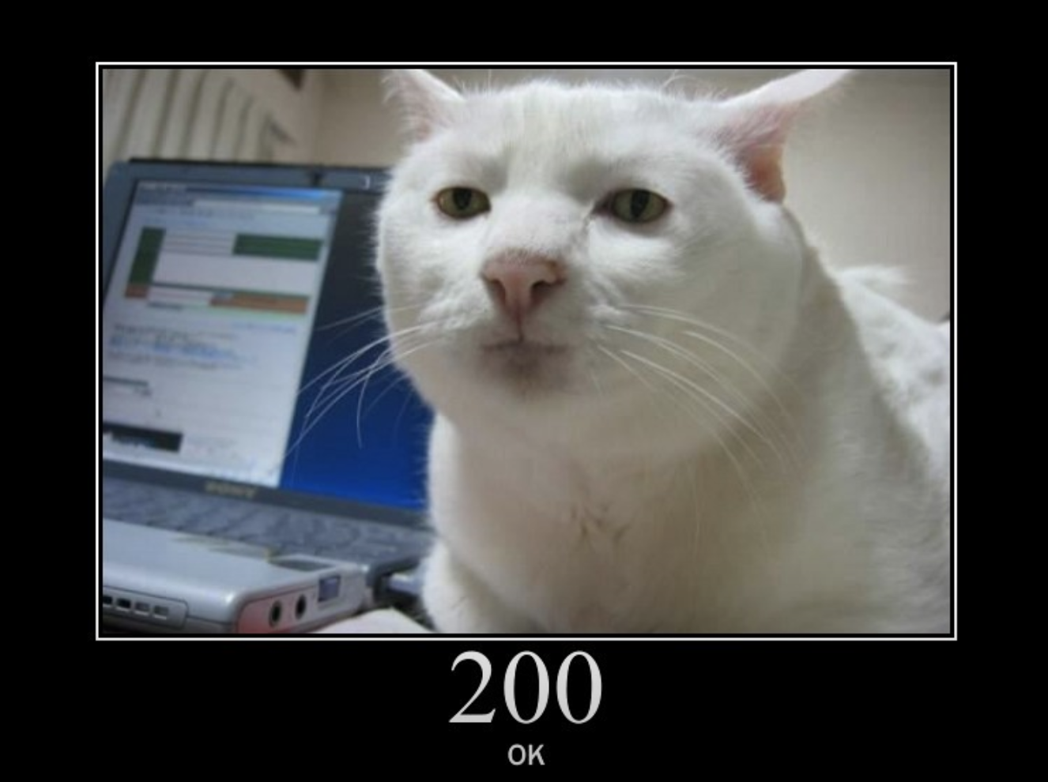



API Response: Status Codes
The HTTP response includes the following elements:
Status code
Headers
Body
Task: check the status code of your response
A successful request returns a status code of 200
404 indicates a bad URL
Check out HTTP cats!

Slide 28
API Response: Header

Slide 30
API Response: Body
Common file formats for the API response are:
JSON
XML

Slide 31
Useful APIs
National Grid Carbon Intensity
BMRS
Octopus Energy
Renewables Ninja

Slide 32
Model Selection
Hierarchical decisions in model selection
Linear regression
Decision tree
Neural network
Choosing a learning algorithm
There are infinitely many models that can be trained with supervised learning for a given task, but not all will be equally good
We want to choose a model that gives the best performance and has appropriate characteristics for the task
Model selection can broadly be split into 3 components:
Choosing a learning algorithm
Hyperparameter tuning
Model fitting
Model fitting is always done computationally using methods such as gradient descent while the other choices might be made manually based on knowledge of the problem or model requirements
Network architecture
Learning rate
Hyperparameter tuning
Coefficients (linear regression)
Decision rules (decision tree)
Model fitting
Fitting is the process of adjusting model parameters to achieve the best performance - usually minimising a loss function
Notes:
Trouble is that the space of possible models is very large!

Slide 33
Choosing a Learning Algorithm
Clear box
Choosing the learning algorithm automatically can be very computationally expensive, so is often done manually
The choice of model is determined based on:
The model’s predictive power
Interpretability
Computational expense
Linear Regression
Decision Tree
K Nearest Neighbours
Interpretability
Random Forest
Neural Network
Black box

Slide 34
Feature Selection

Slide 35
Hyperparameter Tuning
Each learning method has its own hyperparameters which can significantly impact predictive power and convergence time

Slide 36
Overfitting
Models which don’t fit the training data well enough have been underfitted
Models which fit the training data too well have been overfitted
Overfitting is often more of a problem than underfitting
If we did not have a validation set, we would have no way of knowing how our model had performed

Slide 37
Train, Validate, Test
Common approach to splitting data for supervised learning
All labelled data
In order to prevent overfitting, data is split into training and test sets
We can do whatever we like with the training data during model selection
The testing data should only be used once to evaluate the final model
Train
Test
Fit
Validate

Slide 38
How not to do Supervised Learning
The task of supervised learning in practice is to find the best model to fit to our data.
The worst approach: choose a few different models; fit them all to all of the data; choose the one with the smallest error
Less bad approach: split the data into train and test sets; fit all the models; choose the one which performs best on the test set

Slide 39
Cross-Validation and Bootstrapping

Slide 40
The modelr Package

